Slide 1
Python Introduction
Dr. Naveen Kumar
Associate Professor
Amity Institute of Information Technology
Amity University Patna

Slide 2
Python Background
Python was created by the Dutch programmer Guido van Rossum in the late 1980s as a hobby project and was first released in February 1991.
It was designed to be a readable and intuitive scripting language with a focus on simple, clean syntax.
Python is a popular, general-purpose programming language known for its emphasis on code readability and simplicity, which makes it an excellent choice for both beginners and experienced developers. Key features include:
The main limitations of Python programming include its slow execution speed compared to compiled languages, high memory consumption, and limitations in mobile application development and concurrent programming.

Slide 3
Key Milestones
Origins at CWI: Van Rossum began working on Python in December 1989 at the Centrum Wiskunde & Informatica (CWI) in the Netherlands. It was conceived as a successor to the ABC programming language, aiming to fix its limitations and appeal to Unix/C programmers.
The Name: The name "Python" was inspired by the British comedy series Monty Python's Flying Circus, of which van Rossum was a big fan, and it is not about the snake as the name suggests.
First Release (1991): Python 0.9.0 was published to the alt.sources Usenet group, featuring core data types like list and dict, classes with inheritance, and exception handling.
Python 1.0 (1994): This version included new features such as the lambda, map, filter, and reduce functions.
Python 2.0 (2000): A pivotal release that introduced significant new features including list comprehensions, a cycle-detecting garbage collector, and Unicode support.

Slide 4
Key Milestones
Python 3.0 (2008): A major, backward-incompatible revision designed to remove redundant constructs and "fix" some of the language's fundamental design flaws that had accumulated over time. Key changes included making print a function and changing integer division behavior. The transition from Python 2 to 3 was a significant, multi-year community effort that concluded with Python 2.7's official end-of-life in 2020.
Governance Shift (2018): Guido van Rossum stepped down from his role as "Benevolent Dictator for Life" (BDFL), and a five-member Steering Council was elected by the core developers to lead the project's future development and direction.
Modern Era: Python's popularity has soared, particularly in the last decade, becoming a dominant language for data science, machine learning, and artificial intelligence, supported by a rich ecosystem of libraries like TensorFlow, NumPy, and Pandas. It consistently ranks as one of the most popular programming languages worldwide.

Slide 5
Popularity and Usage
Python is widely used for:
Web development
Scripting and automation
Software testing
Data science and machine learning

Slide 6
1. Python for data analysis
2. Python for data visualization
3. Python for machine learning
4. Python in AI and deep learning
5. Python for software development
6. Python for web development
7. Python for task automation and scripting
Monitoring the stock market
Web scraping
Keeping updated a to-do list
Creating bots
Generating lists of random names, colors, phone numbers, currencies, etc.

Slide 7
Features of Python
Simple and Easy to Learn: Python's syntax is clean and often resembles everyday English, using indentation instead of semicolons or brackets to define code blocks.
Free and Open Source: The Python interpreter and extensive standard library are freely available for use, modification, and distribution, even for commercial purposes.
Interpreted Language: Python code is executed line by line at runtime rather than being compiled all at once, which facilitates rapid prototyping and easier debugging.
Dynamically Typed: Developers do not need to explicitly declare variable types (like int or string); the interpreter determines the type at runtime, which saves time and provides flexibility.
High-Level Language: Python abstracts away low-level system details like memory management and hardware interactions, allowing programmers to focus on problem-solving logic.
Object-Oriented Programming (OOP) Support: Python supports OOP concepts such as classes, objects, inheritance, and polymorphism, enabling developers to build modular and reusable code.

Slide 8
Features of Python
Large Standard Library and Robust Ecosystem: Python comes with a vast collection of built-in modules and functions, so developers don't have to write code from scratch for every task. Beyond that, a massive third-party library ecosystem (accessible via the Python Package Index, or PyPI) supports diverse applications in fields like data science (NumPy, Pandas), web development (Django, Flask), and machine learning (TensorFlow, PyTorch).
Cross-Platform Compatibility: Python code can run on major operating systems like Windows, macOS, and Linux with minimal or no modification, making it a portable language.
Extensible and Embeddable: Python's capabilities can be enhanced by integrating modules written in other languages like C or C++, and Python code can be embedded within other applications to provide scripting capabilities.
Extensive Community Support: A large and active community provides abundant resources, tutorials, forums, and ongoing improvements to the language, making help readily available.
These features collectively make Python a versatile and powerful language used in a wide range of real-world applications, from powering backend services for tech giants like Netflix and Google to automating everyday tasks.

Slide 9
Key limitations of Python
Speed Limitations: Python is an interpreted language, meaning code is executed line-by-line at runtime, which makes it slower than compiled languages like C++ or Java. This can be a bottleneck for applications that require high performance, such as video games or real-time systems.
High Memory Consumption: Python's object-oriented nature and flexible data structures lead to higher memory usage compared to other languages. This makes it less suitable for memory-limited environments like embedded systems or mobile devices.
Weak Mobile Computing and Browser Support: Python is not natively supported by web browsers (unlike JavaScript) and is generally not an ideal choice for mobile app development. Languages like Swift (iOS) and Kotlin (Android) are preferred for native mobile applications due to better performance and more mature frameworks.
Global Interpreter Lock (GIL): The default CPython implementation uses a GIL, which prevents multiple native threads from executing Python bytecodes simultaneously within the same process. This limits the true parallelism of multi-threaded programs for CPU-bound tasks, although multiprocessing can be used as a workaround.
Runtime Errors: As a dynamically typed language, Python does not require variable types to be explicitly declared, and type checks are performed at runtime. This means that some errors that would be caught during compilation in statically typed languages can only be found during program execution, requiring more thorough testing.
Underdeveloped Database Access Layers: Compared to other technologies like JDBC and ODBC, Python's database access layers are sometimes considered primitive or less developed, which can pose challenges for applications requiring complex, high-volume database interactions.
Package Management Complexity: While Python has a vast ecosystem of third-party libraries, managing dependencies and resolving version conflicts can sometimes be cumbersome in large projects.

Slide 10
Python Virtual Machine
The Python Virtual Machine (PVM) is the runtime engine of the Python programming language that executes platform-independent bytecode using a stack-based architecture.
The primary components of the PVM architecture and its execution process are:
Bytecode Compiler: When Python source code (.py file) is run, the compiler first translates it into a low-level, platform-independent intermediate representation called bytecode. These instructions are cached in .pyc files.
Memory Management: The PVM manages memory dynamically, including memory allocation and an automatic garbage collector that reclaims unused memory.
Stack-based Execution Engine (Interpreter Loop): The core of the PVM is the interpreter loop, which fetches, decodes, and executes the bytecode instructions sequentially. It is a stack-based machine, meaning it uses a value stack to store and retrieve intermediate values, operands, and results during computations.
Frame Objects: The PVM uses frame objects to manage the runtime environment of a function call, including references to local and global variables, the code object of the function, and the current instruction pointer.
Python Object Model and Standard Library: The PVM maintains the Python object model for all data types (integers, strings, lists, etc.) and interacts with Python's extensive standard library during execution.
This architecture provides Python with its key advantage of cross-platform compatibility: the same bytecode can run on any system that has a compatible PVM installed. The most common implementation of the PVM is part of CPython, the reference implementation of Python.

Slide 11
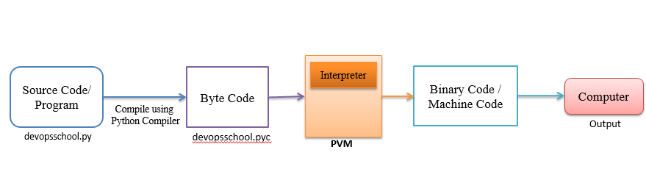
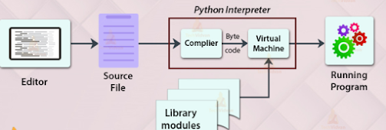

Slide 12
The Python Virtual Machine (VM) is a crucial component of the Python runtime environment. It executes Python bytecode, which is generated from Python source code or intermediate representations like Abstract Syntax Trees (ASTs).
The Python Virtual Machine, often referred to as the Python interpreter, is responsible for executing Python code. It serves as an abstraction layer between the Python bytecode and the underlying hardware, providing a consistent environment for running Python programs across different platforms. The Python VM is implemented in CPython, the reference implementation of Python.

Slide 13
Architecture of the Python Virtual Machine
Bytecode Generation: Before execution, Python source code is compiled into bytecode. This bytecode is a platform-independent intermediate representation of the Python code.
Interpreter Loop: The heart of the Python VM is the interpreter loop. It fetches bytecode instructions, decodes them, and executes them sequentially.
Python Object Model: The Python VM maintains a Python object model to represent data types, such as integers, strings, lists, and custom objects. It manages the creation, manipulation, and destruction of these objects during execution.
Memory Management: The Python VM handles memory allocation and garbage collection to manage the memory used by Python objects dynamically.

Slide 14
Bytecode Execution Process
Loading Bytecode: The Python VM loads bytecode from the compiled .pyc files or directly from memory if the code is generated dynamically.
Interpreter Loop Execution: The interpreter loop fetches bytecode instructions, interprets them, and executes corresponding operations. It maintains a stack to store intermediate values and operands.
Execution of Instructions: Bytecode instructions represent operations like loading values, arithmetic computations, function calls, and control flow (e.g., jumps, loops). The interpreter executes these instructions efficiently.
Runtime Environment Management: The Python VM manages the runtime environment, including namespaces, function calls, exceptions, and module imports.

Slide 15
The architecture comprises of four important parts:
1] Compiler
2] Interpreter
3] Memory manager
4] Stack

Slide 16
From the above figure, let us consider we have a file named “basics.py”.
This is the source file, now the compiler will take this file and do its lexical analysis, syntax analysis, semantics analysis, and then bytecode generation is done.
Provided there are no errors in any of the processes. In Bytecode, it can be compared to instructions in assembly language.
Later, in this Bytecode, if we check in any editor, it would be like certain garbage values as the editor won’t understand the bytecode.
After these states, the interpreter will now come into the picture.

Slide 17
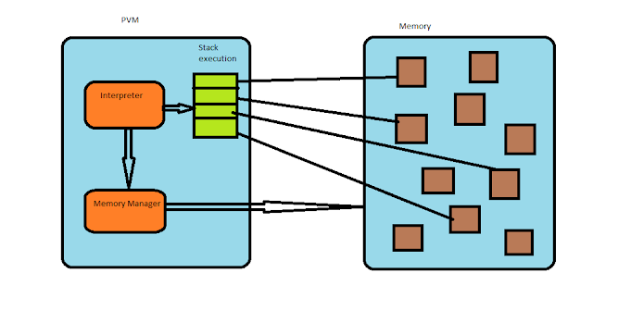

Slide 18
After the generation of the bytecode from the source code now PVM functioning will start.
We have an interpreter, which will take the Bytecode and call the memory manager via some functions or APIs and ask to create a memory object in the memory section.
Using some other API’s Memory manager will create these objects. Also, the interpreter will create a stack for the execution and the memories for the instruction set will be referenced which was the prior task of the memory manager.
So, now in the stack execution, we have something called the Call stack.
It is in the frame format with the Value stack and Block stack being part of each frame.
As we saw earlier we have a memory manager which is responsible for making the links for a memory object.
For the stack in each frame, it will have allocated memory references pointing to these memory objects.

Slide 19
